Slide 1
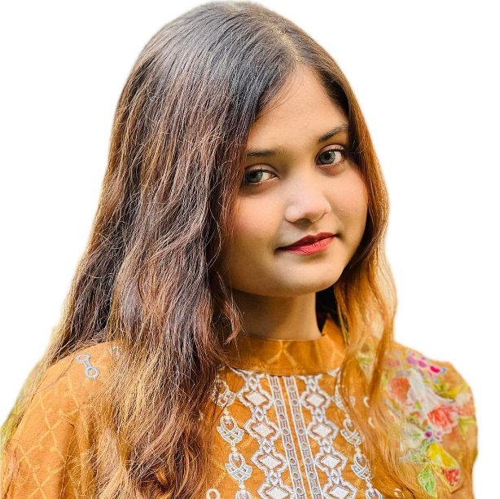



Ariana Anjum
Student
ABOUT ME
EDUCATION
Business Administration student.
I am a responsible and orderly person.
I am looking forward for my first work experience.
INDEPENDENT UNIVERSITY, BANGLADESH
Business Administration
Current
UTTARA HIGH SCHOOL AND COLLEGE
2021
SKILLS
Leadership
Critical Thinking
Public Speech
CONTACT ME
01960616263
COMPUTER SKILLS
arianaanjum@gmail.com
Typing
Uttara,Dhaka
Excel
Slide presentation.
REFERENCE
Dr. Razib Hayat Khan
Assistant Professor
Email; rkhan.iub.edu.bd

